Slide 1
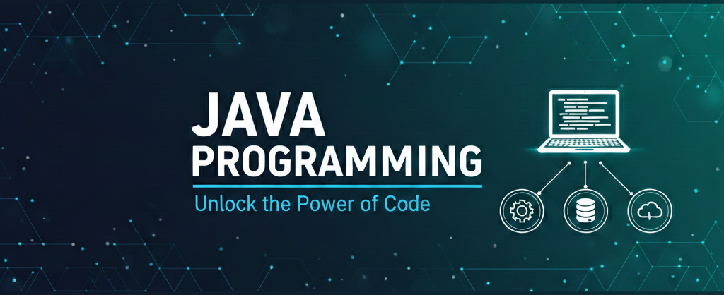
Data Types, Variables & Type Casting
Presenter: Shubham Rawat

Slide 2

Session Objective:
Identify primitive and reference data types in Java
Declare and initialize variables correctly
Understand memory basics for primitives & references
Perform type casting (widening & narrowing)
Use Scanner for user input in programs

Slide 3
Data types

Slide 4
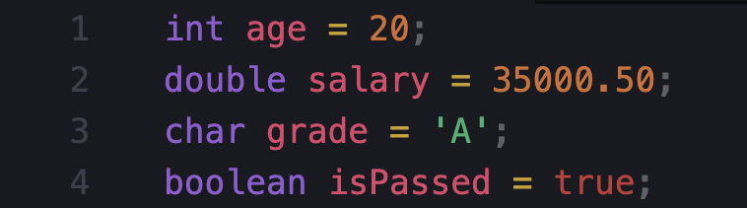
What is a Variable?
Variable = Named memory location used to store data
Rules for variable names
Must start with letter, _ or $
Cannot start with digit
No spaces (use camelCase)
Keywords not allowed (int, class, etc.)

Slide 5
Data Types in Java

Slide 6
Primitive Data Types (8 types)
byte (1 byte)
short (2 bytes)
int (4 bytes)
long (8 bytes)
float (4 bytes)
double (8 bytes)
char (2 bytes)
boolean (true/false)
Non-Primitive (Reference) Types
These store reference/address of objects.
String
Arrays
Classes / Objects
Interfaces

Slide 7
Primitive Types
Type | Used For | Example
byte | very small integers | -10, 100
short | small integers | 2000
int | default integers | 25, 1000
long | very large integers | 9000000000L
float | decimals (less precision) | 3.14f
double | decimals (more precision) | 99.99
char | single character | 'A'
boolean | true/false | true

Slide 8
Integer
byte → small values (memory saving)
short → slightly bigger than byte
int → most commonly used for numbers
long → very large numbers (use L at end)

Slide 9
float vs double
float → decimal values, less precision
double → more precision, most commonly used
By default, Java treats decimals as double

